Slide 1
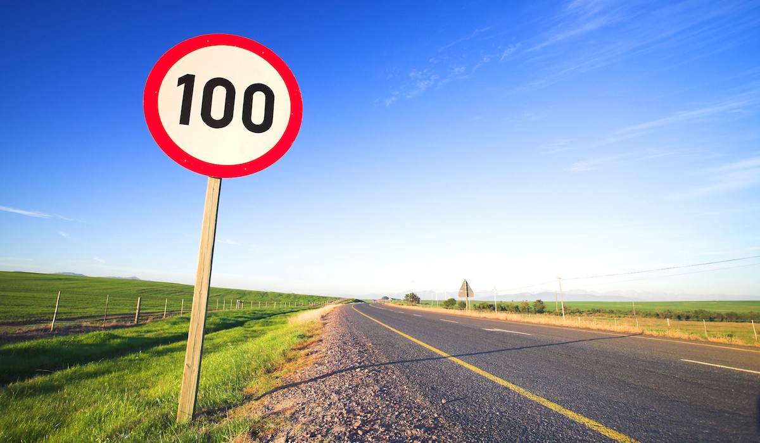
Traffic Sign Classifier

Slide 2
Data Set Summary & Exploration
Basic summary of the data set
Number of training examples = 34799
Number of validation examples = 4410
Number of testing examples = 12630
Image data shape = (32, 32, 3)
Number of classes = 43
I have used the len() function to determine size of training, validation and test sets, and the shape attribute to determine individual image shape, np.unique to get the number of classes.

Slide 3
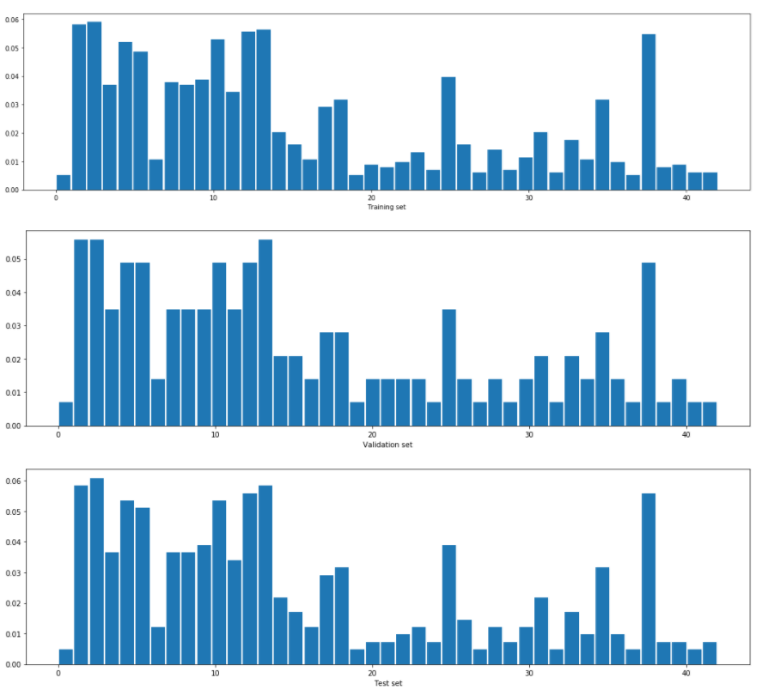
Data Set Summary & Exploration
Exploratory visualization of the dataset
Here we look into the distribution of different traffic signs under the train, validation and test set. The distribution is not even across the classes. Some images are under represented. We will have to watch the performance of our model for these classes to see if they get classified appropriately. However the distribution across different sets is strikingly more similar.

Slide 4
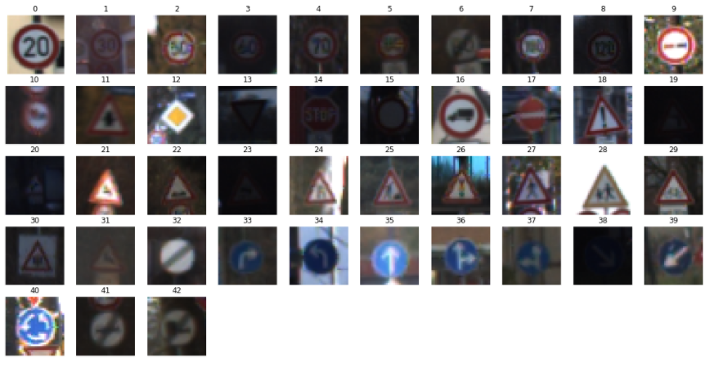
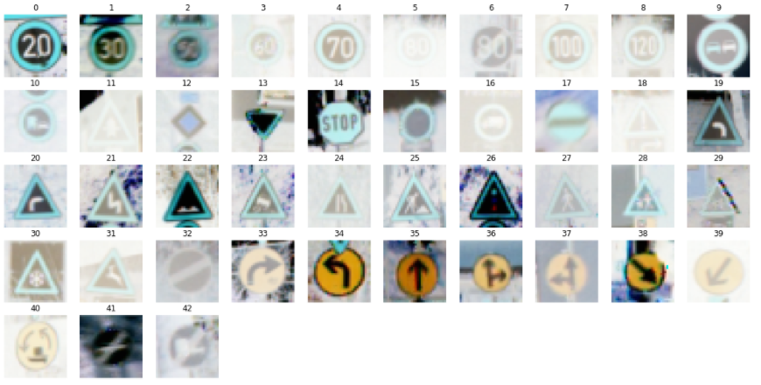
Design and Test a Model Architecture
Image Data Preprocessing
The only preprocessing step applied was to normalize the image data since it is easier and faster to train on a more uniform distribution of the image data. Also it improves the images with poor contrast.
The images were normalized as stated in the notebook hint by subtracting 128 from each pixel value and then dividing by 128.
X_train_normalized = X_train-128.0/128.0
X_valid_normalized = X_valid-128.0/128.0
X_test_normalized = X_test-128.0/128.0
Given are the images, the above is original and the below are normalized. We can see that normalization has increased the brightness of the images and images are more clearer

Slide 5
Design and Test a Model Architecture
Model Architecture
My network is adapted from LeNet architecture adding more
convolution layers with increasing depth and max pooling
layers with stride 1. The model consists of four convolution
layers, two max pooling layers and three fully connected
layers with batch normalization and dropouts. The
following are the layers of the model:
Layer | Description
Input | 32x32x3 RGB image
Convolution 5x5, filter=8 | stride 1x1, valid padding, activation = RELU, output 28x28x8
Convolution 5x5, filter=8 | stride 1x1, valid padding, activation = RELU, output 24x24x8
Batch Normalization
Max pooling | Size 2x2, stride 1x1, valid padding, output 12x12x8
Dropout | 0.2
Convolution 5x5, filter=16 | stride 1x1, valid padding, activation = RELU, output 10x10x16
Convolution 5x5, filter=16 | stride 1x1, valid padding, activation = RELU, output 8x8x16
Batch Normalization
Max pooling | Size 2x2, stride 1x1, valid padding, output 4x4x16
Dropout | 0.2
Flatten | Input 4x4x16, output 256
Fully connected | Input 256, activation = RELU, output 120
Fully connected | Input 120, activation = RELU, output 84
Fully connected | Input 84, activation = Softmax, output 43 (classes)

Slide 6
Design and Test a Model Architecture
Training of Model
To train the model, I used Adam optimizer with following hyperparameters :
Learning rate of 0.001 (default in Keras)
10 epochs
Batch size of 256
Categorical cross entropy as the loss function
I used model checkpointing to save the best weights found during the training.

Slide 7
Design and Test a Model Architecture
Solution Approach
Initially I started with a keras Model of LeNet architecture but with input 32X32X3. I chose LeNet architecture as the architecture is small and faster and trained on 28X28 MNIST image dataset, good for smaller dataset with small image dimensions. Running the test on this model gave out an validation accuracy close to 90% with different epochs (5, 10, 20) but not more. Looking at the validation loss seems to indicate that the model was overfitting as the validation accuracy was below 90% and training accuracy above 97%. The next approach I introduced was batch normalization along with a drop-out of 0.1 to counter the overfitting (cs231n.github.io/neural-networks-2 Batch Normalization and Dropout). This bumped up the validation accuracy by 2-3%. Next I started tweaking the number of filters set on the 2 convolution layers as increasing the number of filters would help extract more image features out of the image. I played with a few combinations (4, 8, 16, 32, 64) and finally settled for 8 in first convolution layer and 16 in the second one considering the accuracy and speed of the network. At this point my accuracy was into the 93 percentile but wanted to check if I could better it. So the next thing I introduced was more convolution layers along the lines of this article (chsasank.github.io/keras-tutorial.html), however I had to remove the stride of 2 on the max pooling layers as the model was running out of the image output space. At this point I had 2 Convolution 5x5, filter=8 and 2 Convolution 5x5, filter=16 layers with dropout increased to 0.2 and was getting accuracy of over 94%. In the end, I changed the last two convolution layers to use kernel size of 3X3 as that would help capture finer image details and it helped increase the accuracy to 96%. This model was smaller (50,459 parameters) and faster and got me the test accuracy of close to 95% with just 5 epochs, so I settled for it.
My final model results were:
Training set accuracy of 99.21 %
Validation set accuracy of 96.03 %
Test set accuracy of 94.02 %

Slide 8
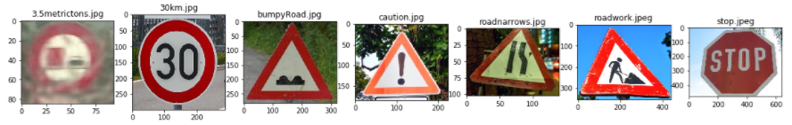
Test Model on New Images
New Test Images from Web
Here are seven German traffic signs that I found on the web
The images are of varying sizes but clear except for the first i.e. No passing for vehicles over 3.5 metric tons image. The varying sizes would be standardized by resizing them all to 32X32X3 and then normalized before predicting their classes.
The first image is blurred by the bad weather and might be difficult to classify with the possibility to be mistaken for no passing.
The fifth image is taken in the night and is rotated and tilted with some background noise (lights) around the sign which can
cause it to be difficult to classify it correctly. The remaining ones should be easy to classify since they are more alike
to the ones already seen in the training phase.

Slide 9
Test Model on New Images
Model prediction on new traffic test images
Here are the results of the prediction:
Image | Prediction | Individual class accuracy in Test set
No passing for vehicles over 3.5 metric tons | No passing for vehicles over 3.5 metric tons | 98.94 %
Speed limit (30km/h) | Speed limit (30km/h) | 96.53 %
Bumpy road | Bumpy road | 93.33 %
General caution | General caution | 81.03 %
Road narrows on the right | General caution | 83.33 %
Road work | Road work | 87.92 %
Stop | Stop | 99.63 %
The model was able to correctly guess 6 of the 7 traffic signs, which gives an accuracy of 85.71%. The road narrows image got mistaken for general caution probably because they look similar, however it is not obvious which one should have been selected since both performed evenly on the test set. The rest were classified correctly which compares favorably to the accuracy of individual classes on the test set.

Slide 10
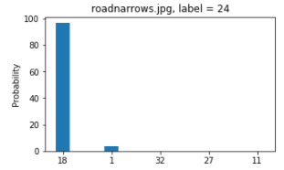
Test Model on New Images
Softmax Probabilities of New Images
The top five softmax probabilities for each image are listed, along with bar charts in the html report. Please refer to the jupyter notebook or html output for the information. The code is located in the cell 11 of the notebook. For all the web test images except for narrowroad.jpg, the model is very certain about its result with probabilities over 99%.
For the Road narrows on the right sign, the model is incorrectly very certain that it is a general caution . On top of the visual similarity between the two signs, this might probably due to the model weights being more favorable to detect general caution when compared to narrow road since we had more instances of it during the training phase and the network has become more adept at extracting the it’s features .
Image - 'roadnarrows.jpg'
96.344147 - 18 (General caution),
3.356030 - 1 (Speed limit (30km/h)),
0.126810 - 32 (End of all speed and passing limits),
0.057640 - 27 (Pedestrians),
0.031680 - 11 (Right-of-way at the next intersection)

